Slide 1

On-Off Time Delay project presentation
Presented BY: Presented TO:
Arifuzzaman-221902201 Maisha Muntaha
Hussain Muhammad Mursalin-221902311 Lecturer,Dept.of CSE GUB
Dept.of CSE GUB

Slide 2

Outlines
Schematics of Time Delay Circuit using 555 Timer IC
Block Diagram of Time Delay Circuit using 555 Timer IC
555 Timer Pinout Configuration
Application of 555 Timer
Components Required
555 Timer IC
Introduction
Conclusion

Slide 3
Components Required
# Serial | Components Name | Ratings | Quantity
01 | 555 Timer IC | - | 1
02 | Capacitor | 470 µF, 0.01µF, 10µF | 3
03 | Resistor | 10 KΩ, 150Ω, 220Ω | 3
04 | Diode | 1N4007 | 1
05 | LED | - | 3
06 | DC Relay | 6V | 1
07 | Transistor | BC547 | 1
08 | Battery | 9V | 2
09 | Breadboard | - | 1
10 | Connecting Wires | - | As required

Slide 4
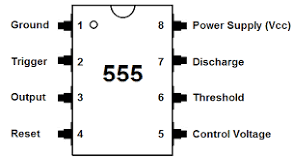
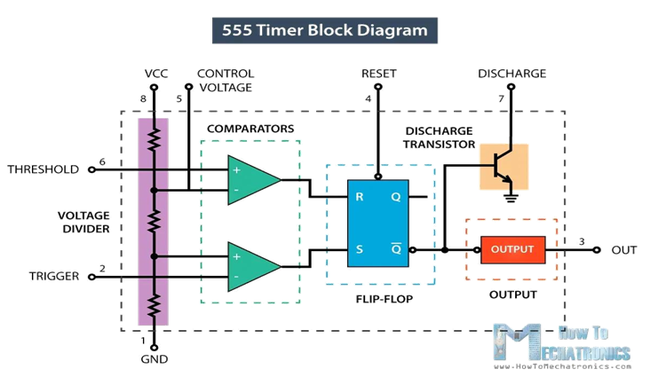
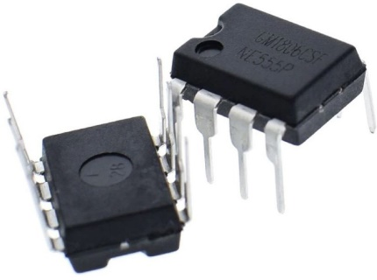

555 Timer Pinout Configuration
Pin 1: GND (Ground)
Pin 2: TRIG (Trigger)
Pin 3: OUT (Output)
Pin 4: RESET
Pin 5: CTRL (Control Voltage)
Pin 6: THRS (Threshold)
Pin 7: DISCH (Discharge)
Pin 8: VCC (Positive Supply Voltage)

Slide 5
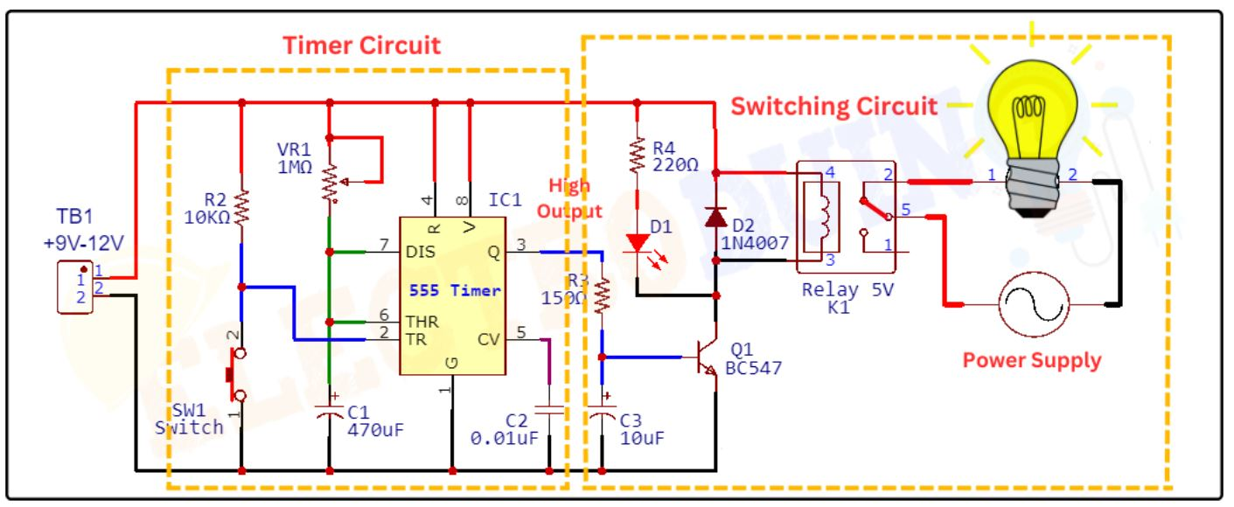
Schematics of Time Delay Circuit using 555 Timer IC

Slide 6
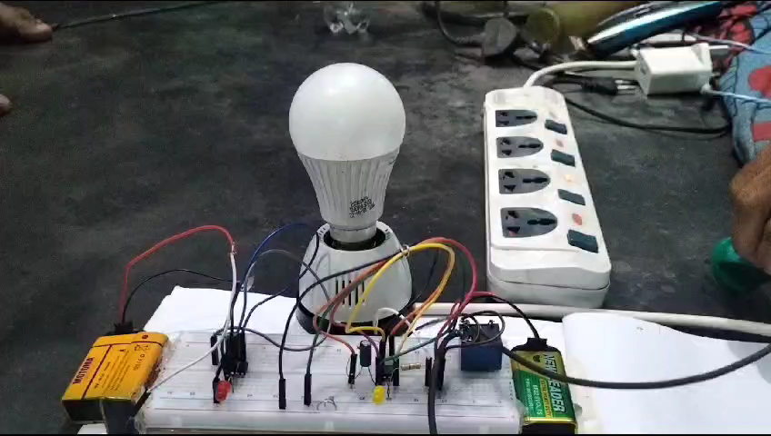
Project working video

Slide 7
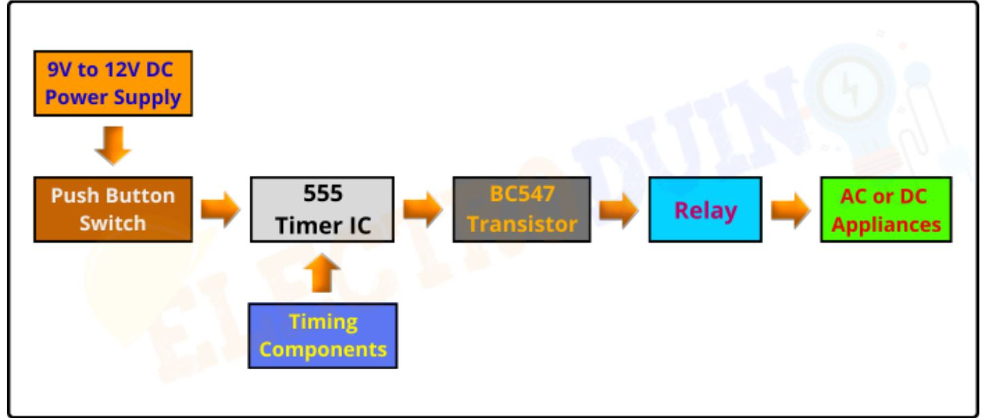
Block Diagram of Time Delay Circuit using 555 Timer IC
Power Supply: Provides 9V to 12V DC power to the circuit.
Push Button Switch: Triggers the timing cycle when pressed.
555 Timer IC: The heart of the circuit, generating the desired time delay.
BC547 Transistor: Acts as a switch, controlled by the 555 timer, to turn the load on or off.
Relay: Handles high-power loads exceeding the transistor's capacity.
AC or DC Appliances: The devices the circuit controls, like lamps, motors, or solenoids.
Timing Components: Resistor and capacitor pair determine the time delay duration.

Slide 8
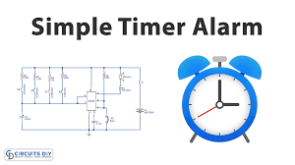

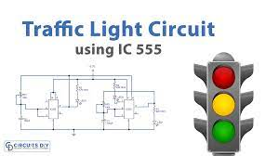

Application Of 555 Timer
Duty Cycle Oscillator
Lamp Dimmer
Analog frequency meters
Quad Timer applications
Pulse, Waveform, and square wave generation
Stepped tone & tone burst generator & linear ramp generation

Slide 9
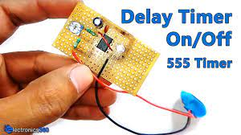
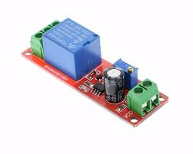
DC Voltage Regulators
Voltage to Frequency Converter
Frequency Divider
Pulse detector
Wiper speed control
Timer Switch

Slide 10
Conclusion
The successful design, construction, and testing of a delay timer circuit for home appliances highlight the practicality and effectiveness of this technology. In practical terms, here is how it can be employed: after creating the 5-minute delay circuit, an additional relay needs to be incorporated to facilitate the connection to a fridge or other appliances. Future work in this area could focus on further enhancing the precision and reliability of the 555 timer delay circuit. This might involve exploring advanced components, developing more compact designs, or integrating digital control interfaces for remote operation and monitoring. Additionally, expanding its application scope to address specific industry needs could open up new avenues for research and development.

Slide 11


